Slide 1
Innovative test solution
Provider
- Probe pin Datasheet -

Slide 2
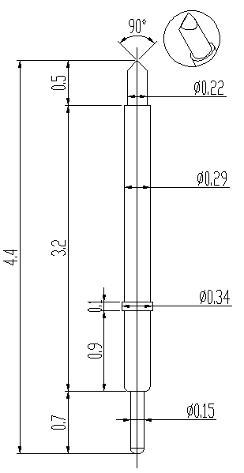
※ POGO type – 0.4 pitch
IVB-SPR-440-029-A208-00
Pitch | 0.4mm
Total Length | 4.4mm
Use Length | 3.9mm
Recommended Stroke | 0.45mm
Max Stroke | 0.5mm
Spring Force at Use Stroke | 27gf at 0.45mm Stroke
Operating Temperature | -40 to 125°C
DC Resistance | TBD
Current Rating | 0.5A
Self Inductance | TBD
Bandwidth @ -1dB | TBD
Top Plunger | BeCu / Au over Ni
Bottom Plunger | BeCu / Au over Ni
Barrel | Phosphor broze / Au over Ni
Spring | Music Wire / Au over Ni
Insertion Life | 100,000 cycles at 0.45mm Stroke

Slide 3
Thank you.

